Slide 1
Classification

Slide 2
The Data Science Pipeline

Slide 3
Vocabulary
Variables:
Quantitative:
Continuous: (Informally) the variable takes on a numeric value in which (theoretically) it can take any of an infinite number of values.
Examples: X = the volume of water in a swimming pool
X = the amount of time to run a 100 meter dash
X = the distance between Dallas and Denver
Discrete: (Informally) the variable takes on a numeric value in which there are a countable number of values possible.
Examples: X = the number of stories of a building.
X = the number of eggs a chicken lays X = shoe size

Slide 4
Vocabulary
Variables:
Qualitative/categorical
Nominal: The variable takes on names or labels that cannot be ordered.
Examples: X = the color of a car
X = the names on a roster
X = the sport a subject plays
Ordinal: The variables takes on a label whose possible value can be ordered.
Examples: X = disagree, neutral, agree
X = absent, mild, moderate, severe X = Likert scale

Slide 5
Classification
Many times it is desirable to predict a label or category of a subject given a set of continuous and/or categorical predictors/features/variables.
Example: Assume we would like to predict (classify) a person’s qualification for a credit card (categorical: yes/no) based on two continuous variables: income and credit score. This person has an income of $92K and a credit score of 694.

Slide 7
Classification Using K Nearest Neighbors (k-NN)

Slide 8
Classification | k-NN Strategy
Assume we would like to predict (classify) a person’s qualification for a credit card (categorical: yes/no) based on two continuous variables: income and credit score.
The person has an income of $92K and a credit score of 694.
One intuitive strategy may be to simply find other people who have applied and been accepted or denied the credit card and compare them to our subject.
Consider the plot to the right where we have observed 11 applicants and recorded their credit rating, income and qualification status.

Slide 9
Classification | k-NN Strategy
Assume we would like to predict (classify) a person’s qualification for a credit card (categorical: yes/no) based on two continuous variables: income and credit score.
Our strategy will be to simply find the three “closest” applicants and let majority rule on whether we will predict that this person qualifies.
First we will plot the subject on the plot.
We will then find the three “closest” subjects in terms of income and credit rating.
But what do we mean by “closest”?

Slide 10
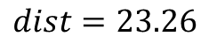
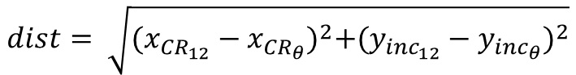
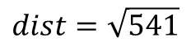
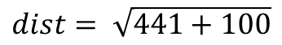
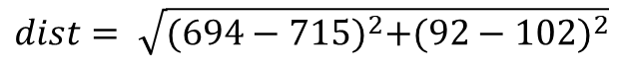
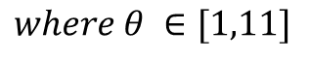
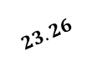
Classification | Euclidean Distance
Assume we would like to predict a person’s qualification for a credit card (categorical: yes/no) based on two continuous variables: income and credit score.
In this case, let’s let “closest” mean in a Euclidean distance sense.
$$23.26$$
$$dist= \sqrt{{(x_{{CR}_{12}}−x_{{CR}_{θ}})}^{2}+{(y_{{inc}_{12}}−y_{inc_{θ}})}^{2}}$$
$$where θ ∈[1,11]$$
Example:
$$dist= \sqrt{{(694−715)}^{2}+{(92−102)}^{2}}$$
$$dist= \sqrt{441+100}$$
$$dist=\sqrt{541}$$
$$dist=23.26$$

Slide 11
Classification | 3-NN Result
Assume we would like to predict a person’s qualification for a credit card (categorical: yes/no) based on two continuous variables: income and credit score.
If we find the distance between the subject and every point and include the three closest point we will have the three points in the circle to the right.
We see that this has two “no” and one “yes”. Therefore, we will predict this subject not to qualify for this credit card.
That is, we will classify this person as a “no”.
We have just observed KNN classification with k = 3.

Slide 13
Classification | 5-NN Result

Slide 14
Classification | 5-NN Result
Assume we would like to predict a person’s qualification for a credit card (categorical: yes/no) based on two continuous variables: income and credit score.
If we find the distance between the subject and every point and include the three closest point we will have the three points in the circle to the right.
We see that this has two “no” and three “yes”. Therefore, we will predict this subject to qualify for this credit card.
That is, we will classify this person as a “yes”.
We have just observed KNN classification with k = 5.
Notes:
# Simple Example Credit Rating as a Function of income and debt
dfTrain = data.frame(income = c(34,67,70,110,89,90,102,104,110,120,170),
CreditRating = c(750,680,670,675,710,690,715,720,650,710,720),
Qualify = c("Yes","No","No","Yes","No","No","Yes","Yes","No","Yes","Yes"))
dfTest = data.frame(income = 92, CreditRating = 694)
knn(dfTrain[,1:2], dfTest, dfTrain$Qualify, k = 5, prob = TRUE)

Slide 16
k-NN in R Using the Class Package

Slide 17
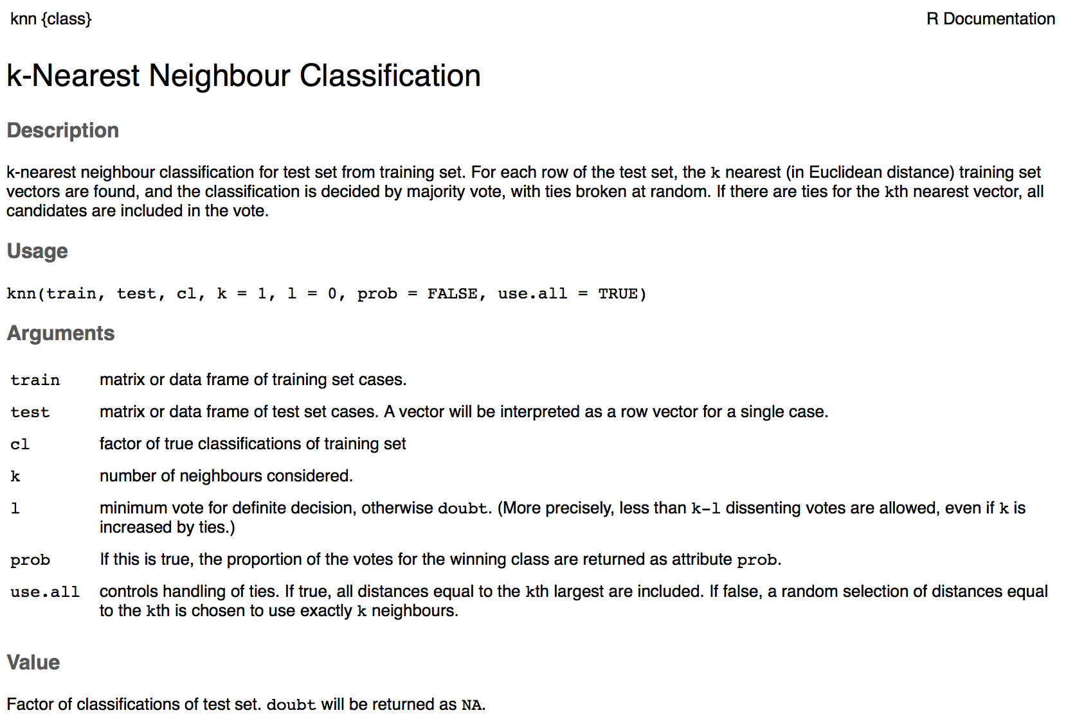
knn() in Class Package

Slide 18
Classification | k-NN Result
Assume we would like to predict a person’s qualification for a credit card (categorical: yes/no) based on two continuous variables: income and credit score.
If we find the distance between the subject and every point and include the three closest point we will have the three points in the circle to the right.
We see that this has two “no” and one “yes”. Therefore, we will predict this subject not to qualify for this credit card.
That is, we will classify this person as a “no”.
We have just observed KNN classification with k = 3.
Notes:
# Simple Example Credit Rating as a Function of income and debt
dfTrain = data.frame(income = c(34,67,70,110,89,90,102,104,110,120,170),
CreditRating = c(750,680,670,675,710,690,715,720,650,710,720),
Qualify = c("Yes","No","No","Yes","No","No","Yes","Yes","No","Yes","Yes"))
dfTest = data.frame(income = 92, CreditRating = 694)
knn(dfTrain[,1:2], dfTest, dfTrain$Qualify, k = 3, prob = TRUE)

Slide 19
Classification | k-NN Result
Assume we would like to predict a person’s qualification for a credit card (categorical: yes/no) based on two continuous variables: income and credit score.
If we find the distance between the subject and every point and include the three closest point we will have the three points in the circle to the right.
We see that this has two “no” and three “yes”. Therefore, we will predict this subject to qualify for this credit card.
That is, we will classify this person as a “yes”.
We have just observed KNN classification with k = 5.
Notes:
# Simple Example Credit Rating as a Function of income and debt
dfTrain = data.frame(income = c(34,67,70,110,89,90,102,104,110,120,170),
CreditRating = c(750,680,670,675,710,690,715,720,650,710,720),
Qualify = c("Yes","No","No","Yes","No","No","Yes","Yes","No","Yes","Yes"))
dfTest = data.frame(income = 92, CreditRating = 694)
knn(dfTrain[,1:2], dfTest, dfTrain$Qualify, k = 5, prob = TRUE)

Slide 21
Example | Classifying Iris Data
Versicolor v. Virginica

Slide 22
Versicolor v. Virginica
Notes:
iris %>% ggplot(aes(x = Sepal.Length,Sepal.Width,color = Species)) + geom_point()

Slide 23
Versicolor v. Virginica
We have a plant with sepal length = 6.20 and sepal width = 2.80 and would like to classify its species: versicolor or virginica.
Notes:
irisVersVirg %>% ggplot(aes(x = Sepal.Length,Sepal.Width,color = Species)) + geom_point() + scale_color_manual(values=c("#00BA38", "#619CFF"))

Slide 24
Versicolor v. Virginica
irisVersVirg = iris %>% filter(Species == "versicolor" | Species == "virginica")
df = data.frame(Sepal.Length = 6.20 , Sepal.Width = 2.80)
knn(irisVersVirg[,c(1,2)], df, irisVersVirg$Species, k = 5, prob = TRUE)
knn(irisVersVirg[,c(1,2)], df, irisVersVirg$Species, k = 15, prob = TRUE)
Notes:
irisVersVirg %>% ggplot(aes(x = Sepal.Length,Sepal.Width,color = Species)) + geom_point() + scale_color_manual(values=c("#00BA38", "#619CFF"))

Slide 26
Evaluating the Model
Cross Validation
Notes:
http://www.cmap.polytechnique.fr/~lepennec/R/Learning/Learning.html

Slide 27
Strategy/Philosophy
In most, if not all, machine learning settings, a goal is to “train” a model with some collected data (we will call the “training data”) and then to see how good the model performs on a representative data set that is separate from the training data (we will call this the “test data”). The key is that the “test” data was not used to train/build the model.
But we only have one dataset right?
What can we do?
Complete dataset
Training data
75% at random
Remaining 25%
Test set

Slide 28
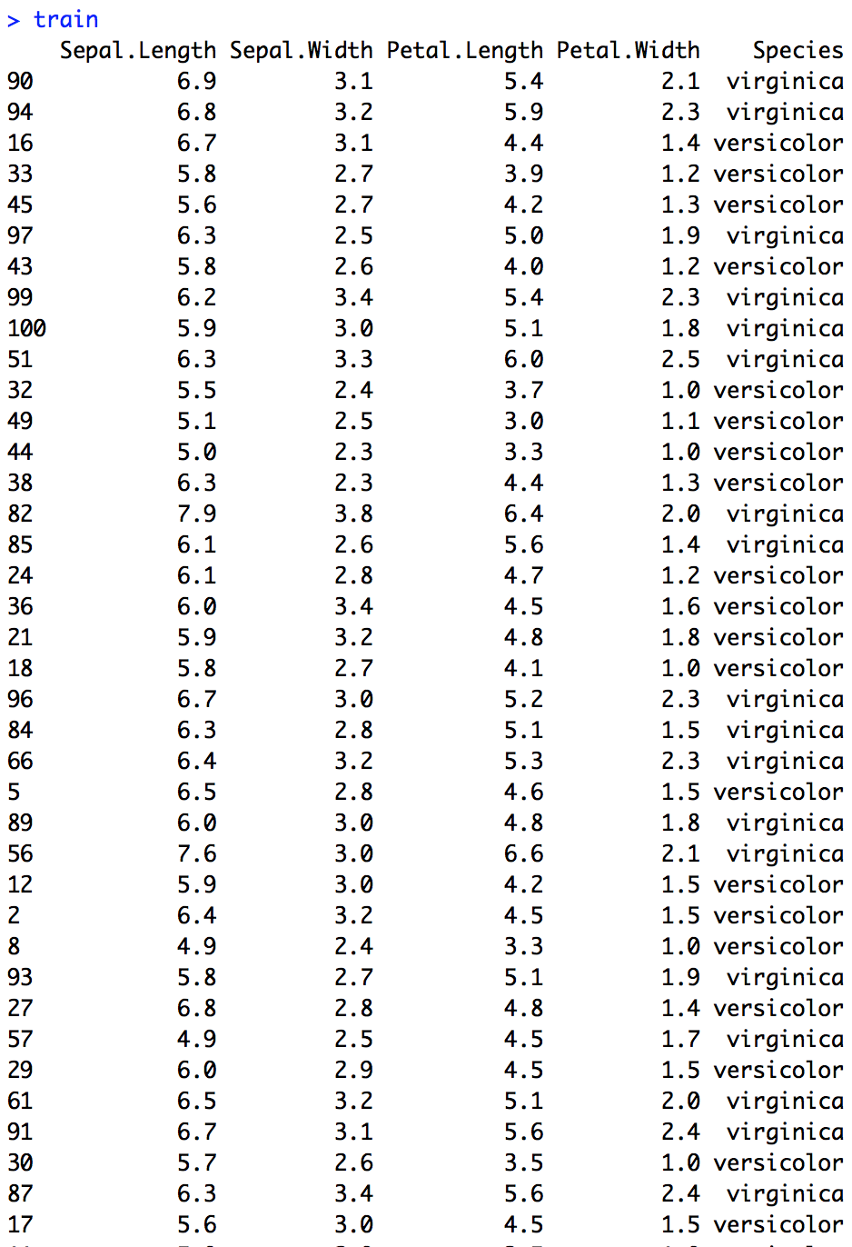
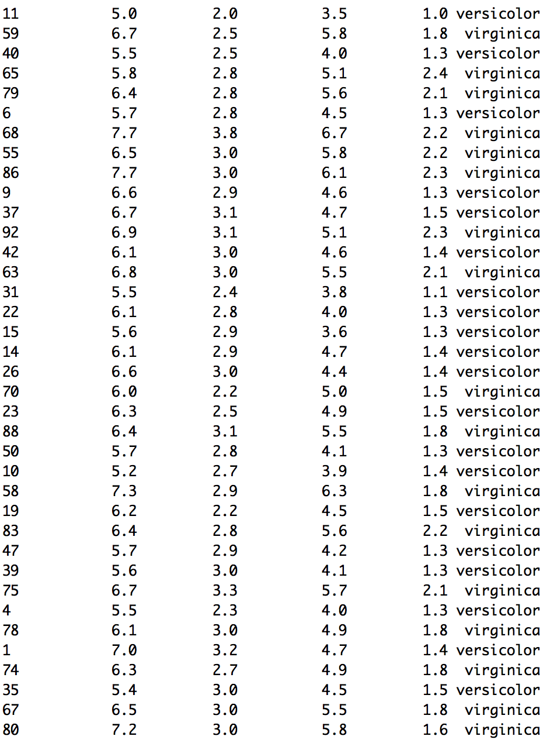
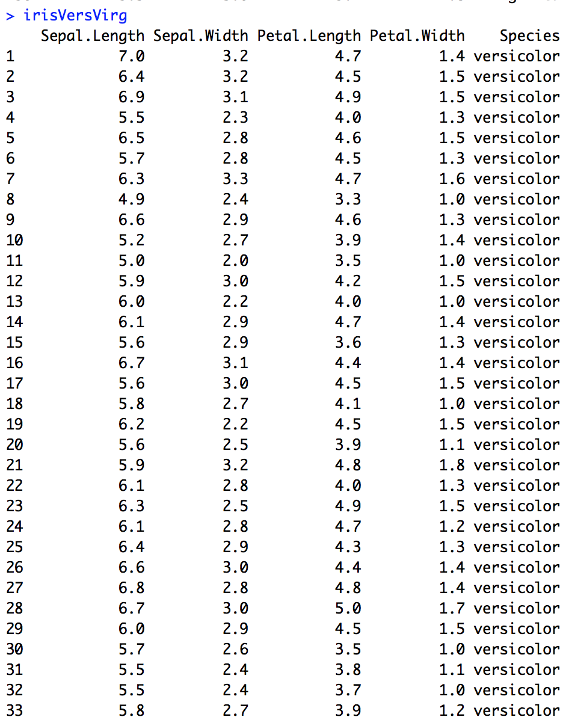
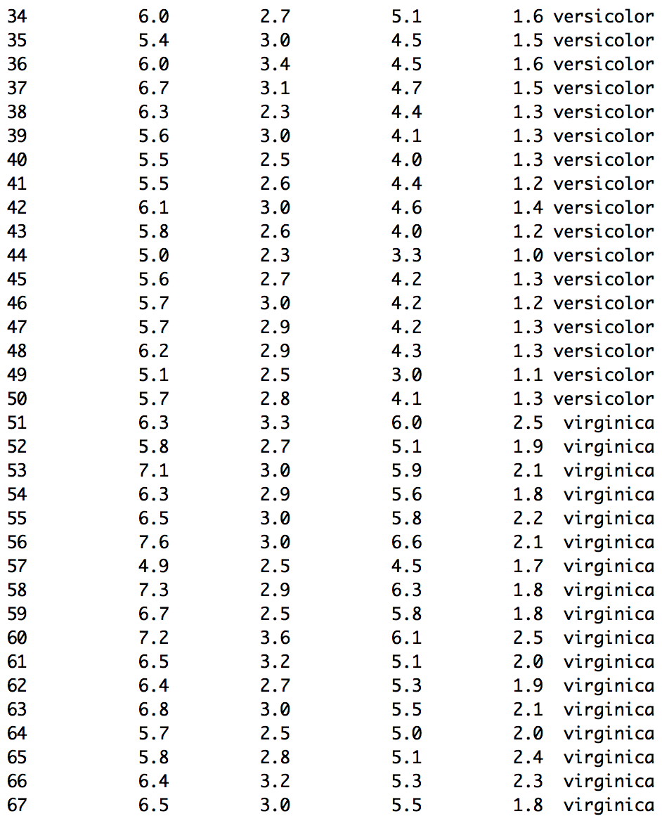
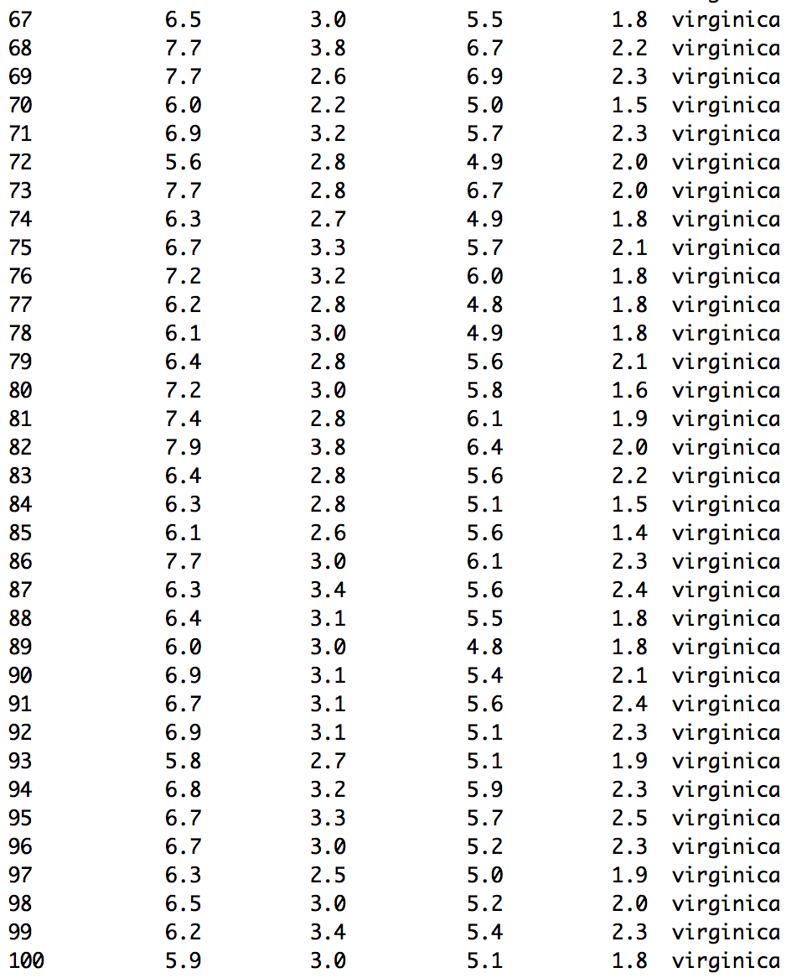
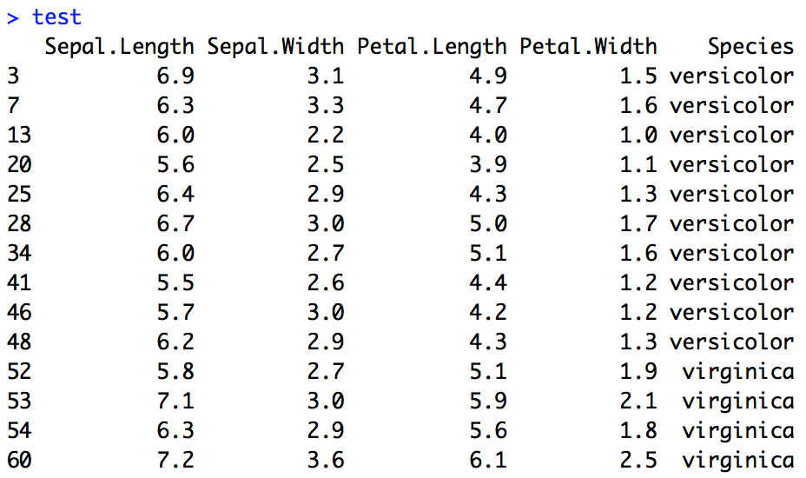
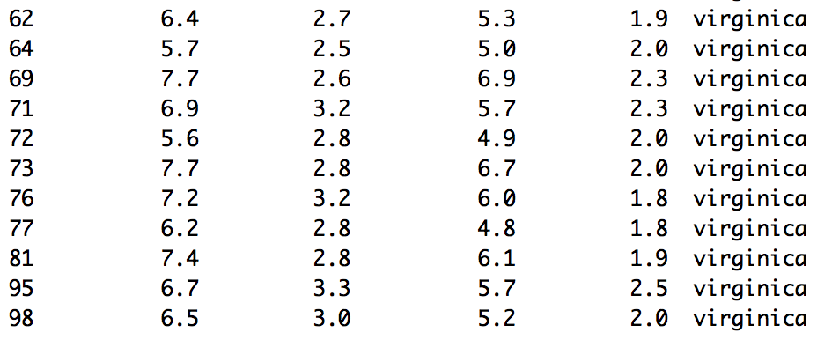
Example: Versicolor v. Virginica
splitPerc = .75
irisVersVirg = iris %>% filter(Species == "versicolor" | Species == "virginica")
trainInices = sample(1:dim(irisVersVirg)[1],round(splitPerc * dim(irisVersVirg)[1]))
train = irisVersVirg[trainInices,]
test = irisVersVirg[-trainInices,]
Train
Full data set
Train
Test
Test

Slide 29
Example: Versicolor v. Virginica
splitPerc = .75
irisVersVirg = iris %>% filter(Species == "versicolor" | Species == "virginica")
summary(irisVersVirg)
irisVersVirg = droplevels(irisVersVirg,exclude = "setosa")
summary(irisVersVirg)
trainIndices = sample(1:dim(irisVersVirg)[1],round(splitPerc * dim(irisVersVirg)[1]))
train = irisVersVirg[trainIndices,]
test = irisVersVirg[-trainIndices,]
irisVersVirg %>% ggplot(aes(x = Sepal.Length,Sepal.Width,color = Species)) + geom_point()
# k = 3
classifications = knn(train[,c(1,2)],test[,c(1,2)],train$Species, prob = TRUE, k = 3)
table(test$Species,classifications)
confusionMatrix(table(test$Species,classifications))
Notes:
accs = data.frame(accuracy = numeric(30), k = numeric(30))
trainIndices = sample(1:dim(irisVersVirg)[1],round(splitPerc * dim(irisVersVirg)[1]))
train = irisVersVirg[trainIndices,]
test = irisVersVirg[-trainIndices,]
for(i in 1:30)
{
classifications = knn(train[,c(1,3)],test[,c(1,3)],train$Species, prob = TRUE, k = i)
table(test$Species,classifications)
CM = confusionMatrix(table(test$Species,classifications))
accs$accuracy[i] = CM$overall[1]
accs$k[i] = i
}
plot(accs$k,accs$accuracy, type = "l")

Slide 30
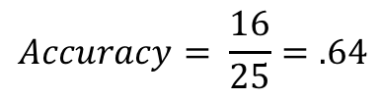
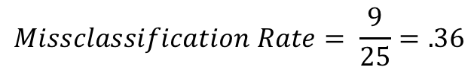
Example: Versicolor v. Virginica
Confusion Matrix
True Species
 | Versicolor | Virginica
Versicolor | 10 | 7
Virginica | 2 | 6
Classifications
$$Accuracy= \frac{16}{25}=.64$$
$$Missclassification Rate= \frac{9}{25}=.36$$
Notes:
accs = data.frame(accuracy = numeric(30), k = numeric(30))
trainIndices = sample(1:dim(irisVersVirg)[1],round(splitPerc * dim(irisVersVirg)[1]))
train = irisVersVirg[trainIndices,]
test = irisVersVirg[-trainIndices,]
for(i in 1:30)
{
classifications = knn(train[,c(1,3)],test[,c(1,3)],train$Species, prob = TRUE, k = i)
table(test$Species,classifications)
CM = confusionMatrix(table(test$Species,classifications))
accs$accuracy[i] = CM$overall[1]
accs$k[i] = i
}
plot(accs$k,accs$accuracy, type = "l")

Slide 31
Example: Versicolor v. Virginica
set.seed(6)
splitPerc = .75
irisVersVirg = iris %>% filter(Species == "versicolor" | Species == "virginica")
summary(irisVersVirg)
irisVersVirg = droplevels(irisVersVirg,exclude = "setosa")
summary(irisVersVirg)
trainIndices = sample(1:dim(irisVersVirg)[1],round(splitPerc * dim(irisVersVirg)[1]))
train = irisVersVirg[trainIndices,]
test = irisVersVirg[-trainIndices,]
irisVersVirg %>% ggplot(aes(x = Sepal.Length,Sepal.Width,color = Species)) + geom_point()
# k = 5
classifications = knn(train[,c(1,2)],test[,c(1,2)],train$Species, prob = TRUE, k = 5)
table(test$Species,classifications)
confusionMatrix(table(test$Species,classifications))
Notes:
accs = data.frame(accuracy = numeric(30), k = numeric(30))
trainIndices = sample(1:dim(irisVersVirg)[1],round(splitPerc * dim(irisVersVirg)[1]))
train = irisVersVirg[trainIndices,]
test = irisVersVirg[-trainIndices,]
for(i in 1:30)
{
classifications = knn(train[,c(1,3)],test[,c(1,3)],train$Species, prob = TRUE, k = i)
table(test$Species,classifications)
CM = confusionMatrix(table(test$Species,classifications))
accs$accuracy[i] = CM$overall[1]
accs$k[i] = i
}
plot(accs$k,accs$accuracy, type = "l")

Slide 32
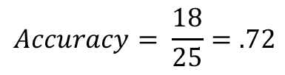
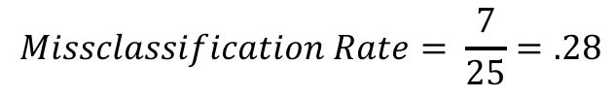
Example: Versicolor v. Virginica
Confusion Matrix
True Species
 | Versicolor | Virginica
Versicolor | 9 | 3
Virginica | 4 | 9
Classifications
$$Accuracy= \frac{18}{25}=.72$$
$$Missclassification Rate= \frac{7}{25}=.28$$
Notes:
accs = data.frame(accuracy = numeric(30), k = numeric(30))
trainIndices = sample(1:dim(irisVersVirg)[1],round(splitPerc * dim(irisVersVirg)[1]))
train = irisVersVirg[trainIndices,]
test = irisVersVirg[-trainIndices,]
for(i in 1:30)
{
classifications = knn(train[,c(1,3)],test[,c(1,3)],train$Species, prob = TRUE, k = i)
table(test$Species,classifications)
CM = confusionMatrix(table(test$Species,classifications))
accs$accuracy[i] = CM$overall[1]
accs$k[i] = i
}
plot(accs$k,accs$accuracy, type = "l")

Slide 33
Example: Versicolor v. Virginica
accs = data.frame(accuracy = numeric(30), k = numeric(30))
trainIndices = sample(1:dim(irisVersVirg)[1],round(splitPerc * dim(irisVersVirg)[1]))
train = irisVersVirg[trainIndices,]
test = irisVersVirg[-trainIndices,]
for(i in 1:30)
{
classifications = knn(train[,c(1,2)],test[,c(1,2)],train$Species, prob = TRUE, k = i)
table(test$Species,classifications)
CM = confusionMatrix(table(test$Species,classifications))
accs$accuracy[i] = CM$overall[1]
accs$k[i] = i
}
plot(accs$k,accs$accuracy, type = "l")

Slide 34
Example: Versicolor v. Virginica
# Loop for many k and the average of many training / test partition
iterations = 100
numks = 30
masterAcc = matrix(nrow = iterations, ncol = numks)
for(j in 1:iterations)
{
accs = data.frame(accuracy = numeric(30), k = numeric(30))
trainIndices = sample(1:dim(irisVersVirg)[1],round(splitPerc * dim(irisVersVirg)[1]))
train = irisVersVirg[trainIndices,]
test = irisVersVirg[-trainIndices,]
for(i in 1:numks)
{
classifications = knn(train[,c(1,2)],test[,c(1,2)],train$Species, prob = TRUE, k = i)
table(test$Species,classifications)
CM = confusionMatrix(table(test$Species,classifications))
masterAcc[j,i] = CM$overall[1]
}
}
MeanAcc = colMeans(masterAcc)
plot(seq(1,numks,1),MeanAcc, type = "l")

Slide 36
Other Classification Statistics

Slide 37
Classification Statistics
True Species
 | Truly Versicolor (“Success”/“Positive”) | Truly Virginica (“Failure”/“Negative”)
Classified as Versicolor | 10 | 4
Classified as Virginica | 5 | 6
Classifications
Accuracy
Number of correctly classified observations/total: 16/25 = .64 = 64%
Misclassification rate:
Number of misclassified observations/total: 9/25 = .36 = 36%
Sensitivity:
Number of correctly identified successes/true number of successes: 10/15 = .66 = 66%
Specificity:
Number of correctly identified failures/true number of failures. 6/10 = .60 = 60%
False positives:
Number of true failures identified as successes/total number of classified successes: 4/14 = .286 = 28.6%
False negatives:
Number of true successes identified as failures/total number of classified failures: 5/11 = .455 = 45.5%
Positive predictive value
Number of classified successes/total number of true successes: 10/14 = .7143 = 71.43%

Slide 38
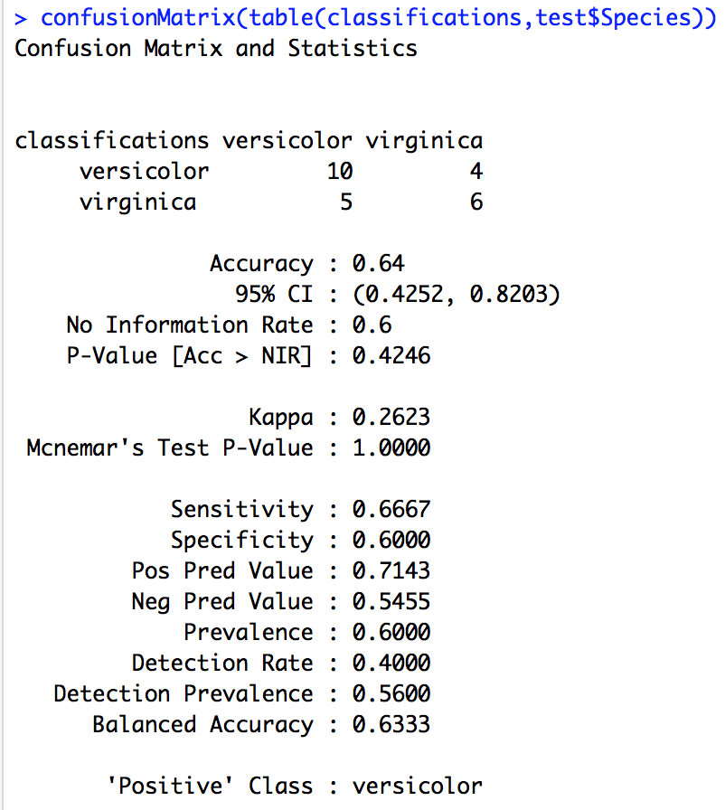
Classification Statistics
True Species
 | Truly Versicolor (“Success”/“Positive”) | Truly Virginica (“Failure”/“Negative”)
Classified as Versicolor | 10 | 4
Classified as Virginica | 5 | 6
Classifications
Accuracy
Number of correctly classified observations/total: 16/25 = .64 = 64%
Misclassification rate:
Number of misclassified observations/total: 9/25 = .36 = 36%
Sensitivity:
Number of correctly identified successes/true number of successes: 10/15 = .66 = 66%
Specificity:
Number of correctly identified failures/true number of failures. 6/10 = .60 = 60%
False positives:
Number of true failures identified as successes/total number of classified successes: 4/14 = .286 = 28.6%
False negatives:
Number of true successes identified as failures/total number of classified failures: 5/11 = .455 = 45.5%
Positive predictive value
Number of classified successes/total number of true successes: 10/14 = .7143 = 71.43%

Slide 40
Internal/Leave One Out CV

Slide 41
External CV
When there isn’t a lot of data, external cross validation may yield small training and test sets.
For example: If n = 20 and we have and 80–20 train/test split: Train set = 16 observations Test set = 4 observations Each observation in the test set is classified based on a k-NN model based on 16 observations.

Slide 42
External CV
When there isn’t a lot of data, external cross validation may yield small training and test sets.
For example: If n = 20 and we have and 80–20 train/test split: Train set = 16 observations Test set = 4 observations Each observation in the test set is classified based on a k-NN model based on 16 observations.

Slide 43
External CV
When there isn’t a lot of data, external cross validation may yield small training and test sets.
For example: If n = 20 and we have and 80–20 train/test split: Train set = 16 observations Test set = 4 observations Each observation in the test set is classified based on a k-NN model based on 16 observations.

Slide 44
External CV
When there isn’t a lot of data, external cross validation may yield small training and test sets.
For example: If n = 20 and we have and 80–20 train/test split: Train set = 16 observations Test set = 4 observations Each observation in the test set is classified based on a k-NN model based on 16 observations.

Slide 45
Internal CV/Leave One Out
With internal/leave one out CV, we classify each observation using a k-NN model trained on the other n-1 observations.
For example: If n = 20 and we have leave one out internal CV: Each classification is based on Train set = 19 observation

Slide 46
Internal CV/Leave One Out
With internal/leave one out CV, we classify each observation using a k-NN model trained on the other n-1 observations.
For example: If n = 20 and we have leave one out internal CV: Each classification is based on Train set = 19 observation

Slide 47
Internal CV/Leave One Out
With internal/leave one out CV, we classify each observation using a k-NN model trained on the other n-1 observations.
For example: If n = 20 and we have leave one out internal CV: Each classification is based on Train set = 19 observation

Slide 48
Internal CV/Leave One Out
With internal/leave one out CV, we classify each observation using a k-NN model trained on the other n-1 observations.
For example: If n = 20 and we have leave one out internal CV: Each classification is based on Train set = 19 observation

Slide 49
Example: Qualify Data
# Simple Example Credit Rating as a Function of income and debt
df = data.frame(income = c(34,67,70,110,89,90,102,104,110,120,170),
CreditRating = c(750,680,670,675,710,690,715,720,650,710,720),
Qualify = c("Yes","No","No","Yes","No","No","Yes","Yes","No","Yes","Yes"))
knn.cv(df[,1:2], df$Quality, k = 3)

Slide 50
Example: Qualify Data
# Simple Example Credit Rating as a Function of income and debt
df = data.frame(income = c(34,67,70,110,89,90,102,104,110,120,170),
CreditRating = c(750,680,670,675,710,690,715,720,650,710,720),
Qualify = c("Yes","No","No","Yes","No","No","Yes","Yes","No","Yes","Yes"))
knn.cv(df[,1:2], df$Quality, k = 3)

Slide 51
Example: Qualify Data
# Simple Example Credit Rating as a Function of income and debt
df = data.frame(income = c(34,67,70,110,89,90,102,104,110,120,170),
CreditRating = c(750,680,670,675,710,690,715,720,650,710,720),
Qualify = c("Yes","No","No","Yes","No","No","Yes","Yes","No","Yes","Yes"))
knn.cv(df[,1:2], df$Quality, k = 3)

Slide 52
Example: Qualify Data
# Simple Example Credit Rating as a Function of income and debt
df = data.frame(income = c(34,67,70,110,89,90,102,104,110,120,170),
CreditRating = c(750,680,670,675,710,690,715,720,650,710,720),
Qualify = c("Yes","No","No","Yes","No","No","Yes","Yes","No","Yes","Yes"))
knn.cv(df[,1:2], df$Qualify, k = 3)

Slide 53
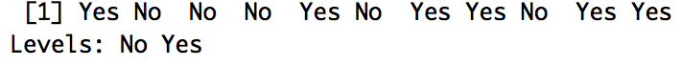
Example: Qualify Data
# Simple Example Credit Rating as a Function of income and debt
df = data.frame(income = c(34,67,70,110,89,90,102,104,110,120,170),
CreditRating = c(750,680,670,675,710,690,715,720,650,710,720),
Qualify = c("Yes","No","No","Yes","No","No","Yes","Yes","No","Yes","Yes"))
classifications = knn.cv(df[,1:2], df$Qualify, k = 3)
classifications

Slide 54
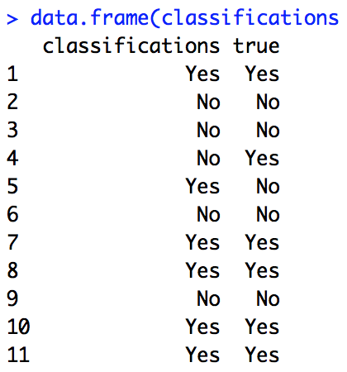
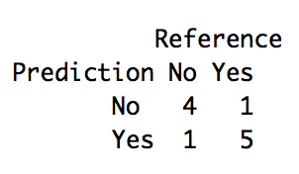
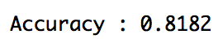
Example: Qualify Data
# Simple Example Credit Rating as a Function of income and debt
df = data.frame(income = c(34,67,70,110,89,90,102,104,110,120,170),
CreditRating = c(750,680,670,675,710,690,715,720,650,710,720),
Qualify = c("Yes","No","No","Yes","No","No","Yes","Yes","No","Yes","Yes"))
classifications = knn.cv(df[,1:2], df$Qualify, k = 3)
classifications
data.frame(classifications = classifications, true = df$Qualify)
confusionMatrix(classifications,df$Qualify)

Slide 56
Standardization

Slide 57
Classification | k-NN Result
Assume we would like to predict a person’s qualification for a credit card (categorical: yes/no) based on two continuous variables: income and credit score.
If we find the distance between the subject and every point and include the three closest point we will have the three points in the circle to the right.
We see that this has two “no” and three “yes”. Therefore, we will predict this subject to qualify for this credit card.
That is, we will classify this person as a “yes”.
We have just observed KNN classification with k = 5.
Notes:
# Simple Example Credit Rating as a Function of income and debt
dfTrain = data.frame(income = c(34,67,70,110,89,90,102,104,110,120,170),
CreditRating = c(750,680,670,675,710,690,715,720,650,710,720),
Qualify = c("Yes","No","No","Yes","No","No","Yes","Yes","No","Yes","Yes"))
dfTest = data.frame(income = 92, CreditRating = 694)
knn(dfTrain[,1:2], dfTest, dfTrain$Qualify, k = 5, prob = TRUE)

Slide 58
Classification | k-NN Result
Assume we would like to predict a person’s qualification for a credit card (categorical: yes/no) based on two continuous variables: income and credit score.
If we find the distance between the subject and every point and include the three closest point we will have the three points in the circle to the right.
We see that this has two “no” and three “yes”. Therefore, we will predict this subject to qualify for this credit card.
That is, we will classify this person as a “yes”.
We have just observed KNN classification with k = 5.
Notes:
# Simple Example Credit Rating as a Function of income and debt
dfTrain = data.frame(income = c(34000,67000,70000,110000,89000,90000,102000,104000,110000,120000,170000),
CreditRating = c(750,680,670,675,710,690,715,720,650,710,720),
Qualify = c("Yes","No","No","Yes","No","No","Yes","Yes","No","Yes","Yes"))
dfTest = data.frame(income = 92, CreditRating = 694)
knn(dfTrain[,1:2], dfTest, dfTrain$Qualify, k = 5, prob = TRUE)

Slide 60
Example
Defaulting Risk

Slide 61
Default Risk
n = 30,000

Slide 62
Default Risk
#read in data
credit = read.csv(file.choose(),header = TRUE)
#make resposnse a factor rather than 0,1
credit$default.payment.next.month = factor(credit$default.payment.next.month,labels = c("NoDefault","Default"))
summary(credit)
#plot the data
credit %>% ggplot(aes(x = AGE, y = LIMIT_BAL,color = default.payment.next.month)) + geom_point()
#Create standardized variables for later.
credit$Z_Lim = (credit$LIMIT_BAL-mean(credit$LIMIT_BAL))/sd(credit$LIMIT_BAL)
credit$Z_AGE = (credit$AGE-mean(credit$AGE))/sd(credit$AGE)
#create training and test sets
trainInd = sample(seq(1,30000,1), .8*30000)
train = credit[trainInd,]
test = credit[-trainInd,]
#Raw Limit and AGE
classifications = knn(train[,c(2,6)],test[,c(2,6)],train$default.payment.next.month,prob = TRUE, k = 5)
confusionMatrix(table(classifications,test$default.payment.next.month))
#Standardized
classifications = knn(train[,c(15,16)],test[,c(15,16)],train$default.payment.next.month,prob = TRUE, k = 5)
confusionMatrix(table(classifications,test$default.payment.next.month))

Slide 63
Default Risk
#tune k (hyperparameter)
iterations = 20
numks = 30
masterAcc = matrix(nrow = iterations, ncol = numks)
for(j in 1:iterations)
{
trainInd = sample(seq(1,30000,1), .8*30000)
train = credit[trainInd,]
test = credit[-trainInd,]
for(i in 1:numks)
{
classifications = knn(train[,c(2,6)],test[,c(2,6)],train$default.payment.next.month,prob = TRUE, k = i)
CM = confusionMatrix(table(classifications,test$default.payment.next.month))
masterAcc[j,i] = CM$overall[1]
}
}
MeanAcc = colMeans(masterAcc)
plot(seq(1,numks,1),MeanAcc, type = "l")

Slide 65
Multinomial Responses | Example
Iris Data

Slide 66
Multinomial Response
We have seen that k-NN is basically a majority rule algorithm.
k-NN can be used when there are more than two levels of the response (multinomial).
k-NN will still look that the point of interest’s k neighbors and the level with the most “votes” wins.
knn() in package class still picks a result at random when there are ties.

Slide 67
Example: Iris Data
Notes:
iris %>% ggplot(aes(x = Sepal.Length,Sepal.Width,color = Species)) + geom_point()

Slide 68
Example: Iris Data
#Iris Example Classification
#Plot
df = data.frame(Sepal.Length = 6.20 , Sepal.Width = 2.80 )
knn(iris[,c(1,2)], df, iris$Species, k = 3, prob = TRUE)
knn(iris[,c(1,2)], df, iris$Species, k = 15, prob = TRUE)

Slide 69
Example: Iris Data
Notes:
iris %>% ggplot(aes(x = Sepal.Length,Sepal.Width,color = Species)) + geom_point()

Slide 70
Example: Iris Data
Notes:
iris %>% ggplot(aes(x = Sepal.Length,Sepal.Width,color = Species)) + geom_point()

Slide 71
Example: Iris Data
Notes:
iris %>% ggplot(aes(x = Sepal.Length,Sepal.Width,color = Species)) + geom_point()

Slide 73
Example
Archeology

Slide 74
Example: Pottery Excavation
Pottery shards are collected from four sites in the British Isles:
L: Llanedyrn
C: Caldicot
I: Isle Thorns
A: Ashley Rails
Each pottery sample was returned to the laboratory for chemical assay. In these assays the concentrations of five different chemicals were determined:
Al: Aluminum
Fe: Iron
Mg: Magnesium
Ca: Calcium
Na: Sodium
QOI: We have found a piece of pottery with the following chemical composition:
Al: 12.3 Fe: 6.7 Mg: 4.9 Ca: 0.10 Na: 0.11
What is the best guess as to its origin?

Slide 75
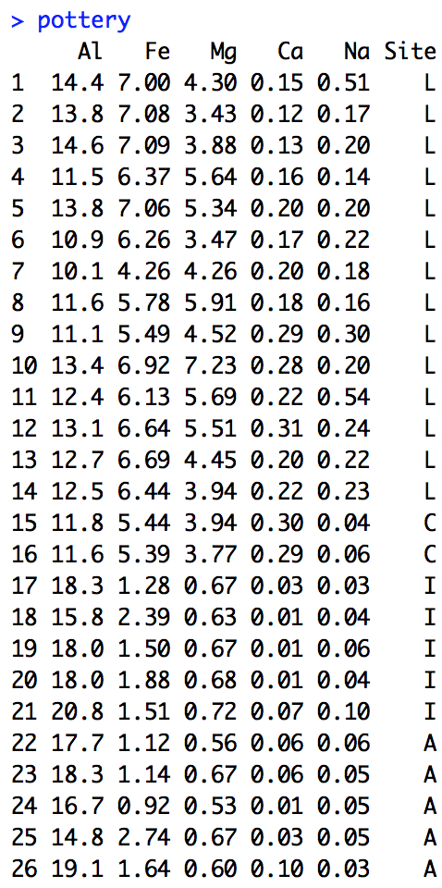
Example: Pottery Excavation
Data is in pottery_data.csv

Slide 76
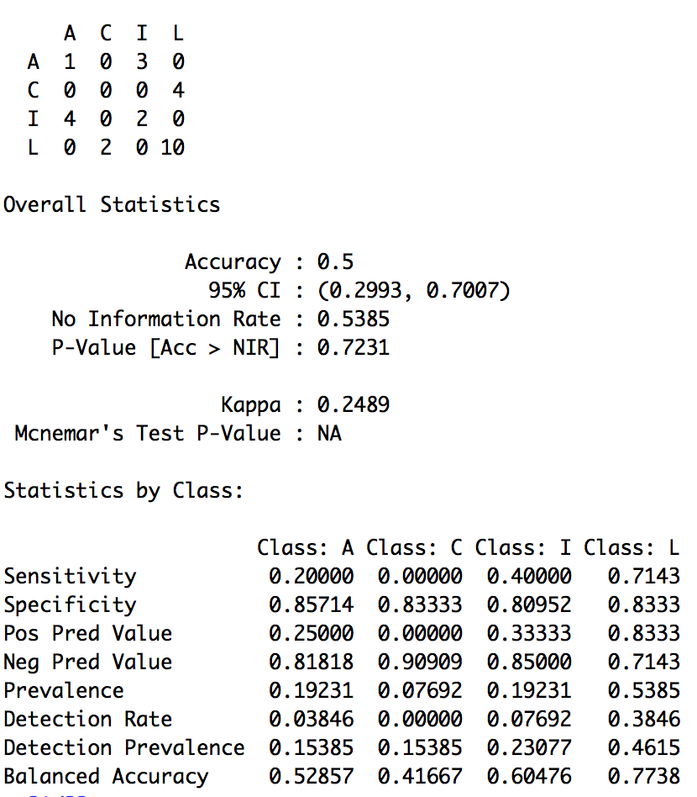
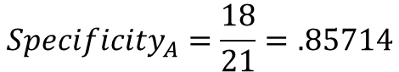
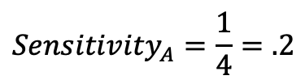
Example: Pottery Excavation
Internal cross validation: 26-fold CV
confusionMatrix(table(knn.cv(pottery[,1:5],pottery$Site, k = 3), pottery$Site))
Actual
$${Sensitivity}_{A}=\frac{1}{4}=.2$$
Classified
$${Specificity}_{A}=\frac{18}{21}=.85714$$

Slide 77
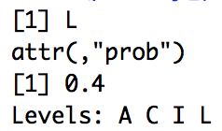
Example: Pottery Excavation
QOI: We have found a piece of pottery with the following chemical composition:
Al = 21 Fe = 6.7 Mg = 4.9 Ca = 0.10 Na = 0.11
What is the best guess as to its origin?
QOI = data.frame(Al = 21, Fe = 6.7, Mg = 4.9, Ca = 0.10, Na = 0.11)
knn(pottery[,1:5],QOI,pottery$Site, prob = TRUE, k = 3)
knn(pottery[,1:5],QOI,pottery$Site, prob = TRUE, k = 5)
Given the chemical makeup of this shard of pottery, with 5-NN classification, there is some evidence to suggests that the shard is from Llanedyrn.

Slide 79
Curse of Dimensionality
Notes:
Software Demo with 3 diminutional plot … distance between A and B and C are close in 2D but far / isolated in 3D.

Slide 80
Curse of Dimensionality
The more dimensions are present the easier it is for an observation to be isolated.
In general, as the dimensions increase, the sample size must also increase substantially in order to provide a setting such that each observation has other observations in the sample that are similar to them in those recorded dimensions.
Let’s look at an example.

Slide 81
Curse of Dimensionality
Need an example here where we show a 2D plot and conclude that we would not feel comfortable classifying an outlier in one of two well defined clusters because it is too far away.
This can extend to where we think things are ”close” in two dimensions but can be very far in 3D. We need to show this with a 2D and 3D plot.

Slide 82
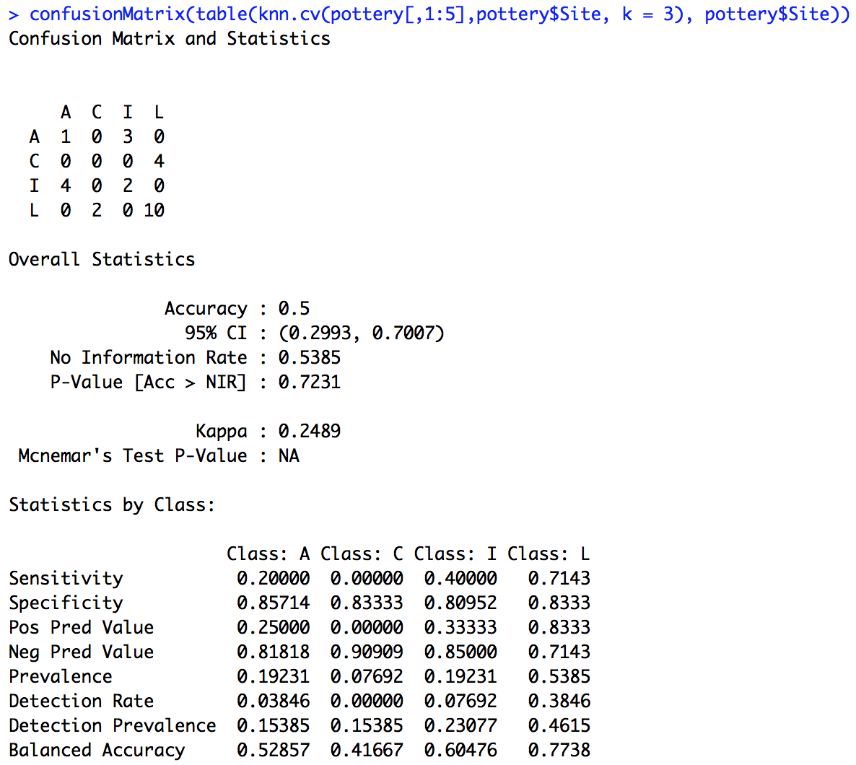
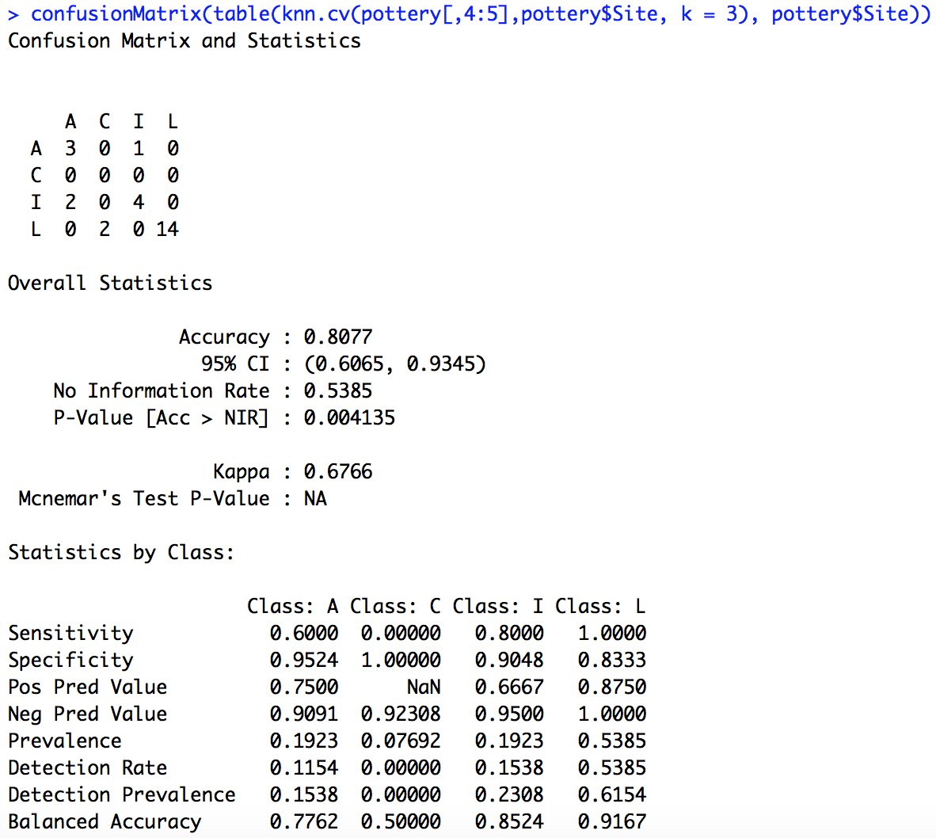
Pottery Example
Five dimensions
Two dimensions

Slide 84
Pottery Example
Discuss the curse of dimensionality.

